Slide 1
USER INTERFACE DESIGN
Unit I

Slide 2
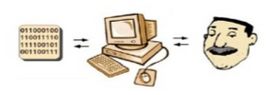
Definition
User Interface is the part of software Program that allow users to interact with computer and carry out their task.
User Interface Design is a subset of a field of study called Human-Computer Interaction.

Slide 3
HCI
Human-Computer Interaction is the study about planning and designing of how people and computer works together so that a person’s needs are satisfied in the most effective way.
Key Points to get focus on Designing:
What people want and expect?
What physical limitations and abilities people possess?

Slide 4
Components of User Interface
The user interface has essential two components: Input and Output
Input is how people communicate his needs to the system using Keyboard or any pointing device
Output is how the system returns processing result to user through screen or sound.
The best interface is one which has proper design with combination of effective input and output mechanisms.

Slide 5
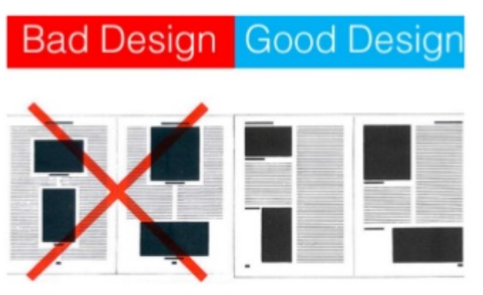
Importance of Good Design
A well-designed interface and screen is important to users.
It increases the productivity.
It is their window to view the capabilities of the system and it is also the vehicle through which complex tasks can be performed.

Slide 6
Importance of Good Design
A screen’s layout and appearance affect a person in a variety of ways.
If they are confusing and inefficient, people will have greater difficulty in doing their jobs and will make more mistakes.
Inspite of today’s rich technologies and tools we are unable to provide effective and usable interface design because lack of time and care.

Slide 7
Effects of a bad design are:
People will have greater difficulty in doing their job
More prone to mistakes
Chase people away from the system
Lead to aggravation, frustration and stress

Slide 8
Benefits of Good Design
Good design reduces software complexity which makes the software easier to understand and modify.
Screens are less crowded
Would be less time consuming, 25 percent less time
Screen would be 20 percent more productive
25 percent fewer errors
Improve decision making time
The organization customers benefit because of improved services
It enables reuse. Good Design makes it easier to reuse code.
It improves software quality .Good design exposes defects and makes it easier to test the software.

Slide 9
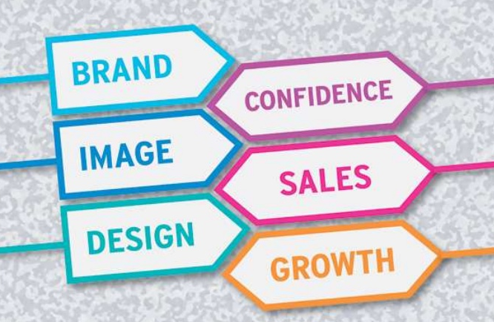

Slide 10
Training costs are lowered because training time is reduced.
Support line costs are lowered because fewer assist calls are necessary, and employee satisfaction is increased because aggravation and frustration are reduced.
Another benefit is, ultimately, that an organization’s customers benefit because of the improved service they receive.
Identifying and resolving problems during the design and development process also has significant economic benefits.

Slide 11
GUI Definition
The graphical user interface (GUI) is a form of user interface that allows users to interact with electronic devices through graphical icons and visual indicators .
GUI Definition. A graphical user interface (GUI) is a human-computer interface (i.e., a way for humans to interact with computers) that uses windows, icons and menus and which can be manipulated by a mouse and keyboard.

Slide 12
GUI
A graphical user interface can be defined as a collection of techniques and mechanisms to interact with something.
In a graphical interface, the primary interaction mechanism is a pointing device of some kind. (Mouse,Joystick,Digital Pen)
What the user interacts with is a collection of elements referred to as objects. They can be seen, heard, touched, or otherwise perceived.
Objects are always visible to the user and are used to perform tasks. They are interacted with as entities independent of all other objects.
People perform operations, called actions, on objects. The operations include accessing and modifying objects by pointing, selecting, and manipulating.

Slide 13
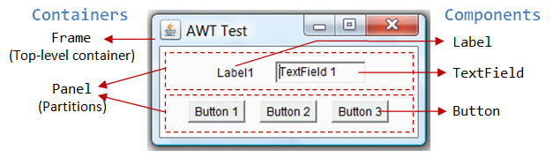
GUI Objects

Slide 14
Characteristics of the Graphical User Interface
Sophisticated Visual Presentation
Visual presentation is the visual aspect of the interface. It is what people see on the screen.
The sophistication of a graphical system permits the follwoing:
Displaying lines, including drawings and icons.
Displaying of a variety of character fonts, including different sizes and styles.
Displaying 16 million or more colors on the screen
Displays animation,presentation,photographs and motion video.

Slide 15
The meaningful interface elements visually presented to the user in a graphical system include windows (primary, secondary, or dialog boxes), menus (menu bar, pulldown, pop-up, cascading), icons to represent objects such as programs or files, assorted screen-based controls (text boxes, list boxes, combination boxes, settings, scroll bars, and buttons), and a mouse pointer and cursor.
The objective is to reflect visually on the screen the real world of the user as realistically, meaningfully, simply, and clearly as possible.

Slide 16
Pick-and-Click Interaction
To identify a proposed action is commonly referred to as pick, the signal to perform an action as click.
The primary mechanism for performing this pick-and-click is most often the mouse and its buttons and the secondary mechanism for performing these selection actions is the keyboard.
Restricted Set of Interface Options
The array of alternatives available to the user is what is presented on the screen or what may be retrieved through what is presented on the screen, nothing less, and nothing more. This concept fostered the acronym WYSIWYG (What You See Is What You Get).

Slide 17
Visualization
Visualization is a cognitive process that allows people to understand information that is difficult to perceive, because it is either too big or too small.
Specialized Graphic pictures facilitate visualization.
The goal is to reproduce a realistic graphical image and conveys the most relevant information.
Effective visualizations can facilitate mental insights, increase productivity and more accurate use of data.
Object Orientation
A graphical system consists of objects and actions. Objects are what people see on the screen as a single unit.
Objects can be composed of sub objects .For example, an object may be a word document and its subobjects may be a paragraph, sentence, word, and letter.

Slide 18
Objects are divided into three meaningful classes as Data objects, which present information, container objects to hold other objects and Device objects, represent physical objects in the real world.
Characteristics of the objects depending upon the relationship exit between them. These relationships are called collections, constraints, composites, and containers.
Properties or Attributes of Objects : Properties are the unique characteristics of an object. Properties help to describe an object and can be changed by users.
Actions : People take actions on objects. They manipulate objects in specific ways (commands) or modify the properties of objects (property or attribute specification).

Slide 19
The following is a typical property/attribute specification sequence:
The user selects an object—for example, several words of text.
The user then selects an action to apply to that object, such as the action BOLD.
The selected words are made bold and will remain bold until selected and changed again.
Application versus Object or Data Orientation :
An application-oriented approach takes an action: object approach, like this:
Action> 1. An application is opened (for example, word processing). Object> 2. A file or other object selected (for example, a memo).
An object-oriented object:action approach does this:
Object> 1. An object is chosen (a memo).
Action> 2. An application is selected (word processing).

Slide 20
Views
Views are ways of looking at an object’s information. IBM’s SAA CUA describes four kinds of views: composed, contents, settings, and help.
Use of Recognition Memory
Continuous visibility of objects and actions encourages to eliminate “out of sight, out of mind” problem
Concurrent Performance of Functions
Graphic systems may do two or more things at one time. Multiple programs may run simultaneously.
It may process background tasks (cooperative multitasking) or preemptive multitasking.
Data may also be transferred between programs. It may be temporarily stored on a “clipboard” for later transfer or be automatically swapped between programs.

Slide 21
Concept of Direct Manipulation
The term used to describe this style of interaction for graphical systems was first used by Shneiderman (1982). He called them “direct manipulation” systems, suggesting that they possess the following characteristics:
The system is portrayed as an extension of the real world:
It is assumed that a person is familar with the objects and actions, replicate them on different medium of screens.
It focused on the data not the applications and tools.
A person has power to modify the objects.
The physical organization of the system, which most often is unfamiliar, is hidden from view.

Slide 22
Continuous visibility of objects and actions:
Objects are continuously visible.
Actions to be performed by label buttons replacing complex syntax and commands.
Reminders of actions to be performed are also obvious. Nelson (1980) described this concept as “virtual reality,” a representation of reality that can be manipulated.
Hatfield (1981) is credited with calling it “WYSIWYG” (what you see is what you get) and Rutkowski (1982) described it as “transparency,”

Slide 23
Direct Manipulation - Characterisitics
Actions are rapid and incremental with visible display of results :
The results of actions are immediately displayed visually on the screen in their new and current form. Auditory feedback may also be provided.
The impact of a previous action is quickly seen
The evolution of tasks is continuous and effortless.
Incremental actions are easily reversible: Finally, actions, if discovered to be incorrect or not desired, can be easily undone.

Slide 24
Limitations
All the operation is difficult to conceptualize in the graphical system
The graphics capability of the system is limited.
The amount of space available for placing manipulation controls in the window border is limited.
It is difficult for the people to remember all the necessary operations and actions

Slide 25
Indirect Manipulation
Style of interaction applied indirectly.
It substitutes words and text for pull down or pop up menus.
It substitutes typing for pointing.

Slide 26
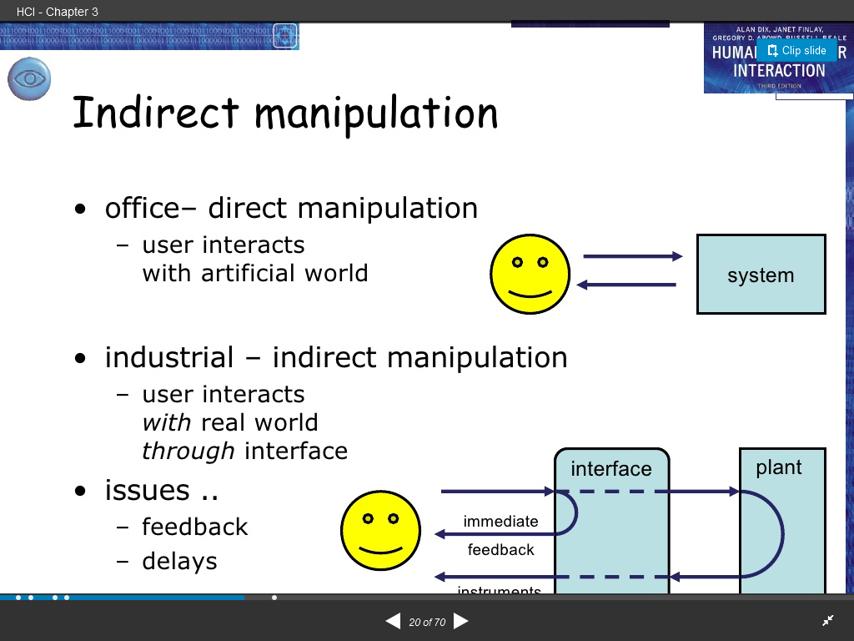

Slide 27
Graphical system advantages
The success of graphical systems has been attributed to a host of factors. The following have been commonly referenced in literature and endorsed by their advocates as advantages of these systems.
Symbols recognized faster than text: symbols can be recognized faster and more accurately than text. An example of a good classification scheme that speeds up recognition is the icons. These icons allow speedy recognition of the type of message being presented.
Faster learning:
A graphical, pictorial representation aids learning, and symbols can also be easily learned.

Slide 28
Faster use and problem solving: Visual or spatial representation of information has been found to be easier to retain and manipulate and leads to faster and more successful problem solving.
Easier remembering: Because of greater simplicity, it is easier for casual users to retain operational concepts.
More natural: symbolic displays are more natural and advantageous because the human mind has a powerful image memory.
Fewer errors: Reversibility of actions reduces error rates because it is always possible to undo the last step. Error messages are less frequently needed.
Increased feeling of control: The user initiates actions and feels in control. This increases user confidence

Slide 29
Predictable system responses: Predictable system responses also speed learning.
More attractive: Direct-manipulation systems are more entertaining, cleverer, and more appealing.
May consume less space: Icons may take up less space than the equivalent in words but this is not the case always.
Replaces national languages: Icons possess much more universality than text and are much more easily comprehended worldwide.
Easily augmented with text displays: Where graphical design limitations exist, direct-manipulation systems can easily be augmented with text displays. The reverse is not true.
Low typing requirements: Pointing and selection controls, such as the mouse or trackball, eliminate the need for typing skills.

Slide 30
Graphical system disadvantages
As the coin has two sides, Graphical system also have both advantages and disadvantages. The following are the few disadvantages of Graphical system.
Greater design complexity: Controls and basic alternatives must be chosen from a pile of choices numbering in excess of 50. This design potential may not necessarily result in better design unless proper controls and windows are selected. Poor design can undermine acceptance.
Learning still necessary: The first time one encounters many graphical systems, what to do is not immediately obvious. A severe learning and remembering requirement is imposed on many users because meanings of icons or using pointing device have to be learned.

Slide 31
Lack of experimentally-derived design guidelines: today there is a lack of widely available experimentally-derived design guidelines. Earlier only few studies to aid in making design decisions were performed and available for today now. Consequently, there is too little understanding of how most design aspects relate to productivity and satisfaction.
Inconsistencies in technique and terminology: Many differences in technique, terminology, and look and feel exist among various graphical system providers, and even among successive versions of the same system. So the user has to learn or relearn again while shifting to next terminology.

Slide 32
Not always familiar: Symbolic representations may not be as familiar as words or numbers. Numeric symbols elicit faster responses than graphic symbols in a visual search task.
Window manipulation requirements: Window handling and manipulation times are still excessive and repetitive. This wastes time.
Production limitations: The number of symbols that can be clearly produced using today’s technology is still limited. A body of recognizable symbols must be produced that are equally legible and equally recognizable using differing technologies. This is extremely difficult today.
Few tested icons exist: Icons must be researched, designed, tested, and then introduced into the marketplace. The consequences of poor or improper design will be confusion and lower productivity for users.

Slide 33
Inefficient for touch typists: For an experienced touch typist, the keyboard is a very fast and powerful device.
Not always the preferred style of interaction: Not all users prefer a pure iconic interface. User will also prefer alternatives with textual captions.
Not always fastest style of interaction: graphic instructions on an automated bank teller machine were inferior to textual instructions.
May consume more screen space: Not all applications will consume less screen space. A listing of names and telephone numbers in a textual format will be more efficient to scan than a card file.
Hardware limitations: Good design also requires hardware of adequate power, processing speed, screen resolution, and graphic capability.

Slide 34
Popularity of Graphics
Graphics revolutionized design and the user interface. Graphics assumes three dimensional look whereas text based system assumes one dimensional look.
Information can appear or disappear through floating windows and navigation and commands can be done through menu or pull downs or screen controls.
Increased computer power and the vast improvement in the display enable the user’s actions to be reacted to quickly, dynamically, and meaningfully.
If properly used graphics can reduce mental and perceptional load and increases information transfer between men and machine because of visual comparisons and simplification of the perception of structure.

Slide 35
The Web User Interface
Web interface design is essentially the design of navigation and the presentation of information.
Proper interface design is largely a matter of properly balancing the structure and relationships of menus, content, and other linked documents or graphics. The design goal is to build a hierarchy of menus and pages that feels natural, is well structured, is easy to use, and is truthful.

Slide 36
The Web is a navigation environment where people move between pages of information, not an application environment. It is also a graphically rich environment.
Web interface design is difficult for a number of reasons. First, its underlying design language, HTML. Next, browser navigation retreated to the pre-GUI era.
Web interface design is also more difficult because the main issues concern information architecture and task flow, neither of which is easy to standardize. It is more difficult because of the availability of the various types of multimedia, and the desire of many designers to use something simply because it is available. It is more difficult because users are ill defined, and the user’s tools so variable in nature.

Slide 37
Principles
Principle 1: Clarity
User interface must be clear in visual appearance, concept & wording.
Principle 2: Aesthetically Pleasing
A design is aesthetically pleasing if it is attractive to the eye
Principle 3:Compatibility
User Compatibility
Task and Job Compatibility
Product Compatibility
Principle 4:Comprehensibility
user should know what to look at, what to do, when to do it, where to do it, why to do it & how to do it.
Principle 5:Configurability
Principle 6:Consistency
It can reduce requirements for human learning by allowing skills learned in one situation to be transferred to another like it

Slide 38
Principle 7:Control
The user must control the interaction & never be interrupted for errors
Principle 8:Directness
Tasks are performed by directly selecting an object then selecting an action performed & then seeing the action being performed.
Principle 9:Efficiency
Transition between various systems controls should flow easily & freely.
Navigation paths should be as short as possible
Principle 10:Familiarity
Familiar concepts enable people to get started & become productive quickly.
Principle 11: Flexibility
Flexibility is the system’s ability to respond to individual differences in people.
permitting system customization.
Principle 12: Forgiveness
People will make mistakes; a system should be able to tolerate those that are common & unavoidable.
A forgiving system keeps people out of trouble.

Slide 39
Principle 13: Predictability
All actions should lead to results the user expects.
Current operations should provide clues as to what will come next.
Principle 14: Recovery
A person should be able to retract any action by issuing an undo command.
Recovery should be obvious,automatic,easy & natural to perform.
Principle 15: Responsiveness
A user must be responded quickly.
Substantial or more informative feedback is most important for the casual or new system user.
All requests must be acknowledged in some way.
Principle 16:Simplicity
Principle 17: Transparency
Permit the user to focus on the task or job without concerning the mechanics of the interface.
Working & reminders of workings inside the computer should be invisible to the user.

Slide 40
Principle 18: Trade-offs
Final design will be based on a series of trade-offs balancing often-conflicting design principles.
People’s requirements always take precedence over technical requirements.

